Slide 1
Welcome to
My Presentation

Slide 2

Course Title : Software Development Project-II & Industrial Tour
Course Code : CSE-3116
Project Supervisor,
Md. Mezbahul Islam
Assistant Professor,
Dept of CSE,
MBSTU.
Presented By,
Md. Shakhawat Hossain
Id : CE-17054,
3rd Year ; 2nd Semester.
Session : 2016-17

Slide 3
CSE
Connectivity

Slide 4
Introduction
From the name of the Project, we can understand that it is the App to connect all.
Yes, ‘CSE Connectivity’ is a mobile application to store data of all the students to connect them.
It is a software program which is implemented by using ‘Java’ for Android mobile application.
I used ‘Android Studio’ to complete the project.
‘Firebase Database’ is used for storing information in online.
‘SQLite’ is used for storing information in user’s device which is very similar to ‘SQL’ database language.

Slide 5
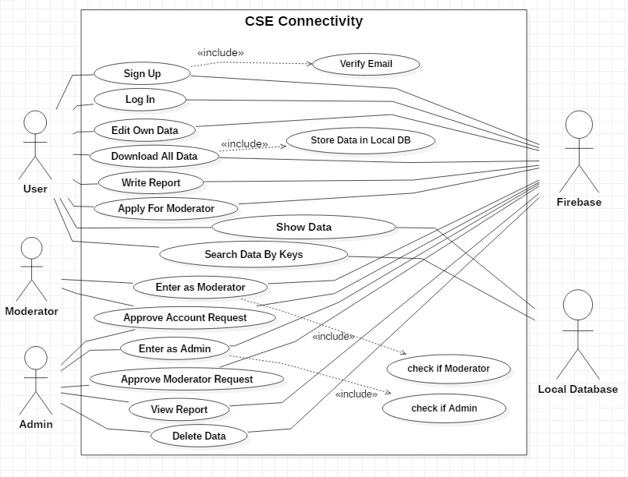
Use Case Diagram

Slide 6
Creating Account
At first User have to Sign Up his information.
The sign up information is stored in “project/ account_request/…” directory.
If Admin or Moderator accept his request, this information will move to “project/users/…” directory.
Then the User will receive a verification email and he have to click the link to confirm his account.
There is a feature to recover account, if forget password.
For encrypting the password, I used special function with secret keys.

Slide 7
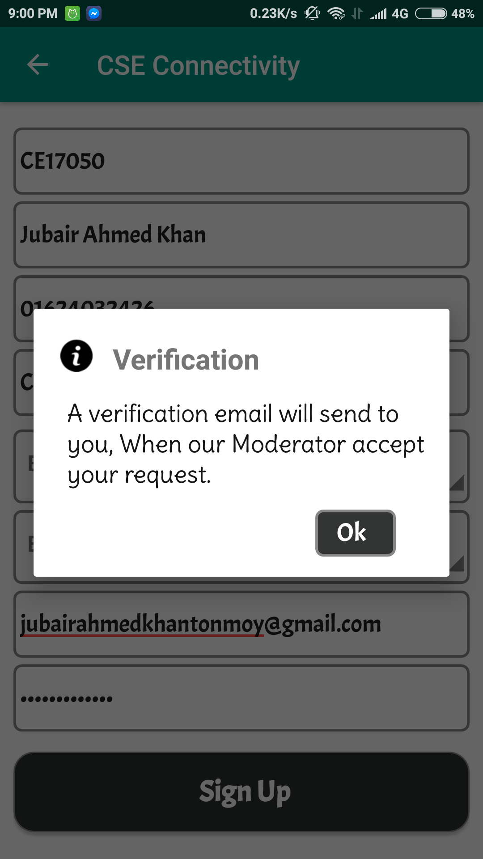
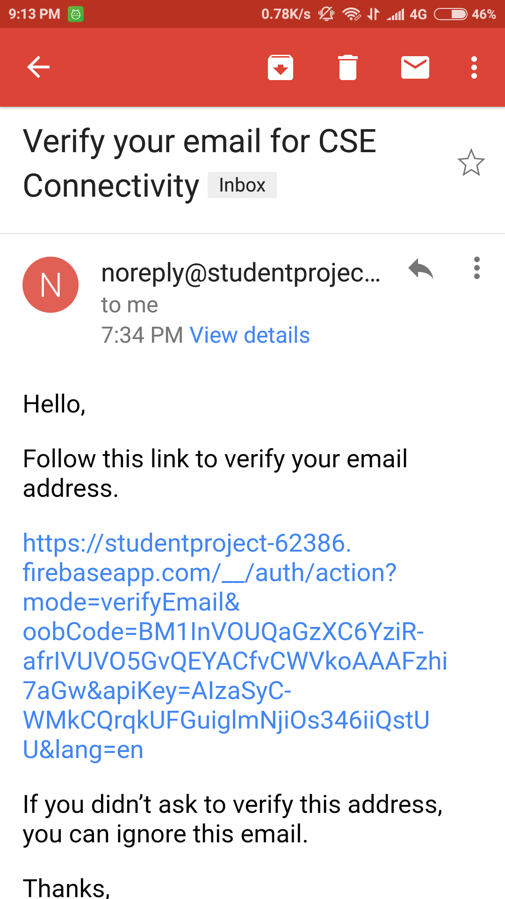
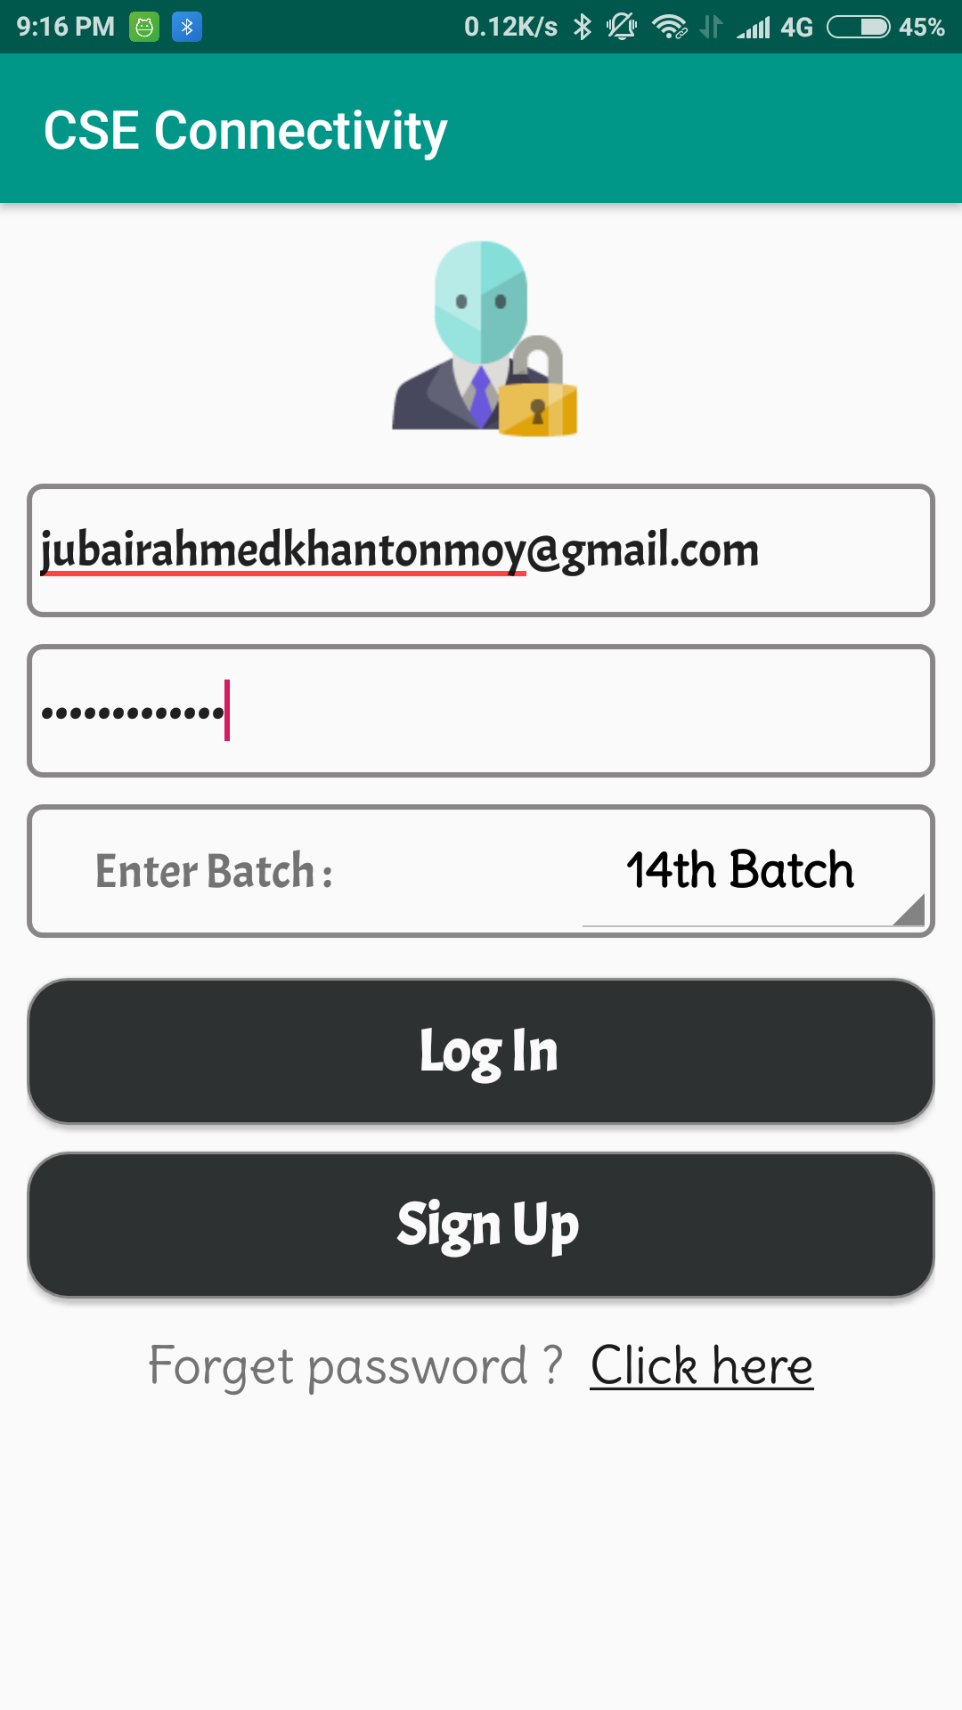
Process of Creating Account
Sign Up
Verifying Email
Log In

Slide 8
Introduction to Home Activity
After Log in, the User will be in the Home Activity.
This is the root activity to go all other activity.
In the content we have some Card Views with Batch name to see information by Batch.
There is a special Card View named as Search to search any one by key information.
In the upper right corner a download icon is given for downloading all user’s information.
If we slide right we will see a Drawer Layout where all the functionalities are given.

Slide 9
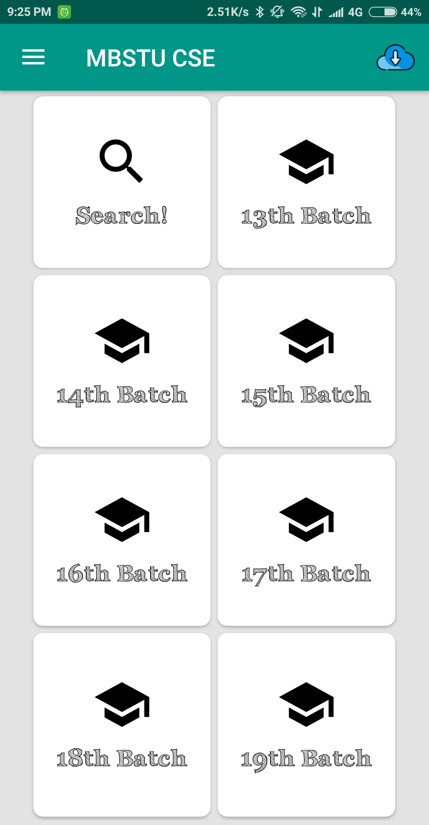
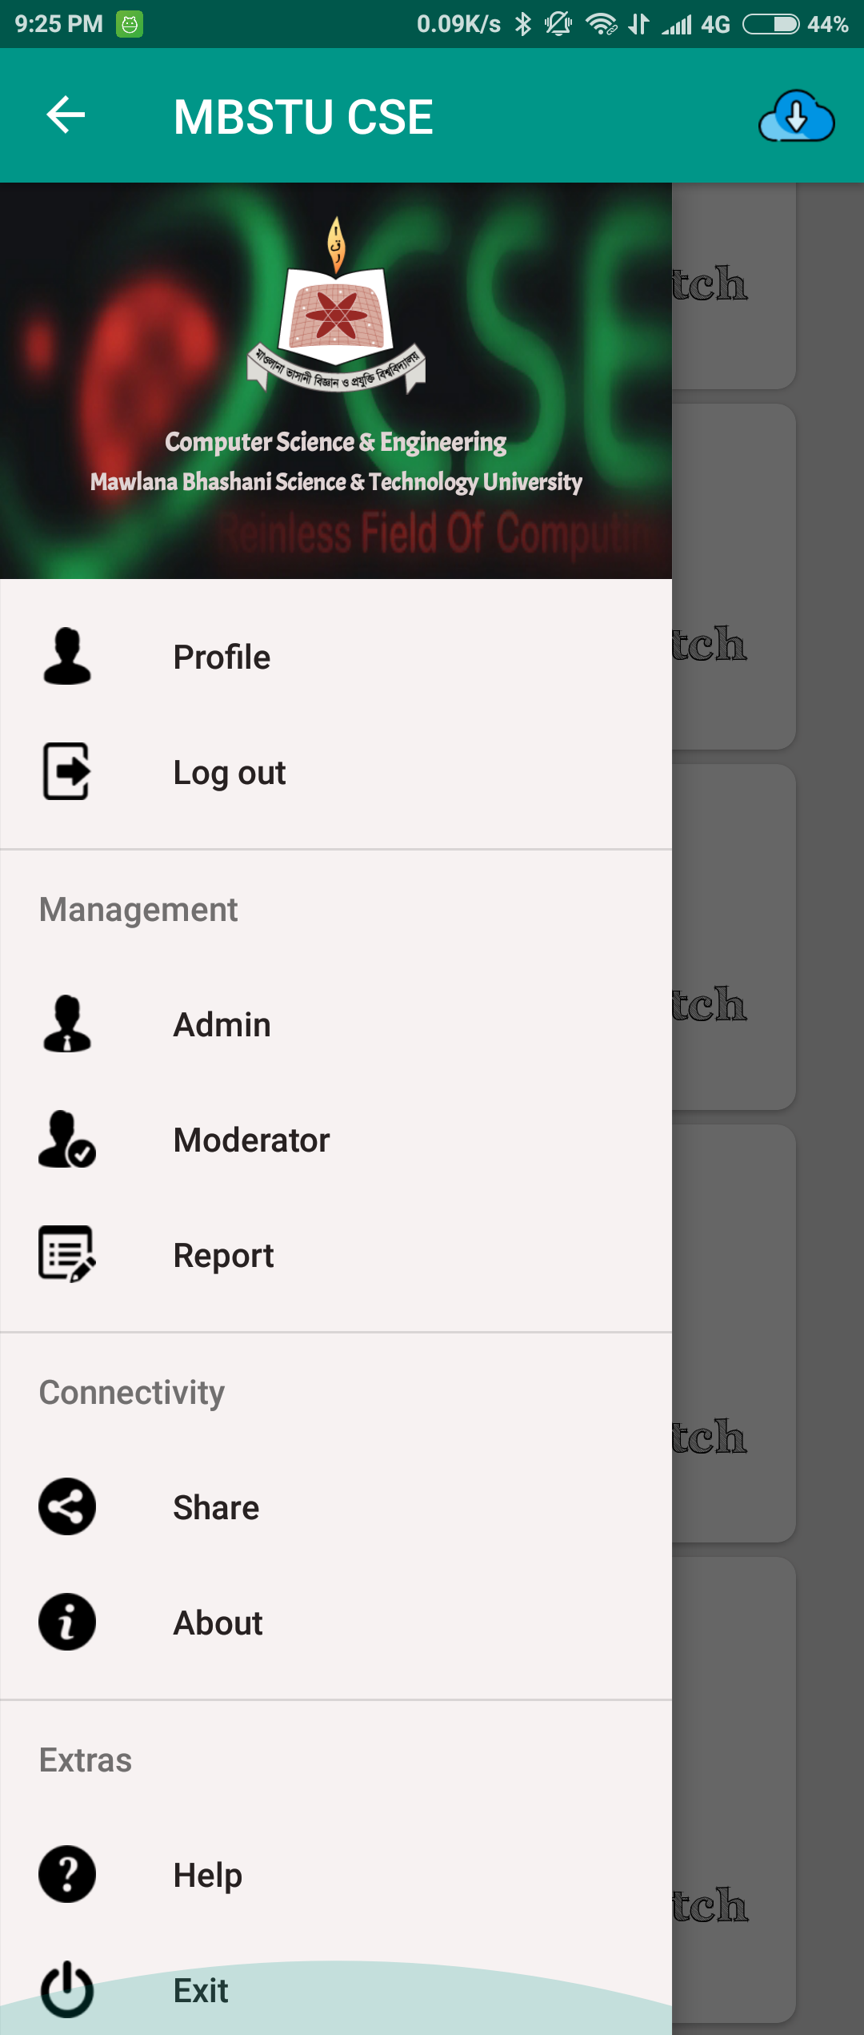
Home Activity in Mobile
On Clicking Hamburger icon
Home Activity
Drawer Layout

Slide 10
Moderator
User may Apply for being Moderator and can enter as Moderator, if ‘is Moderator’ is set to 1 .
Moderator has accessibility over ‘Account Request’ of his batch only.
For viewing Requests, Request Adapter is added.
Inside this Request Adapter ‘onAccept()’ , ‘onIgnore()’ , ‘onClick()’ methods are implemented.
onAccept() method moves the data to the users directory.
onIgnore() method removes the request from Firebase.
onClick() method shows the data in a Alert Dialog.

Slide 11
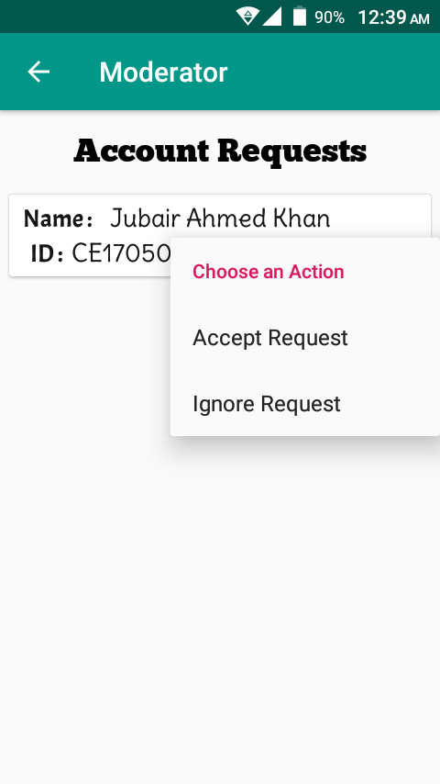
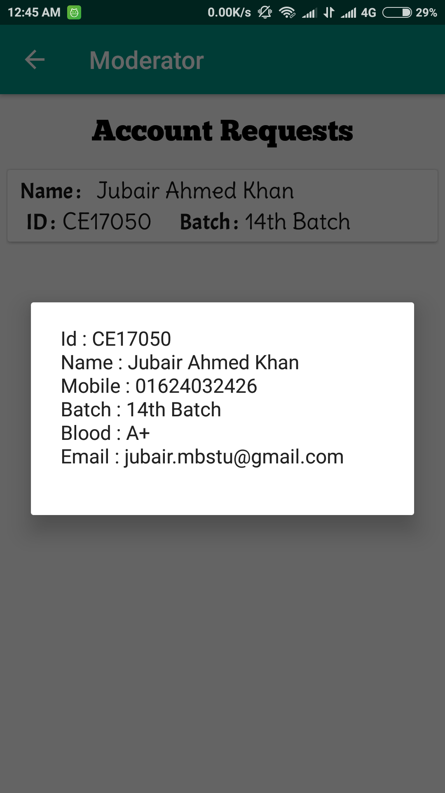
Moderator (Account Request)
Accept the request And send verification email.
Delete the request.
Long tap over any Request
On Click over any request

Slide 12
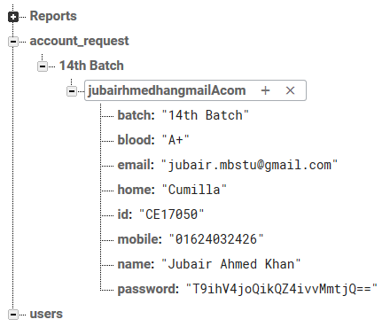
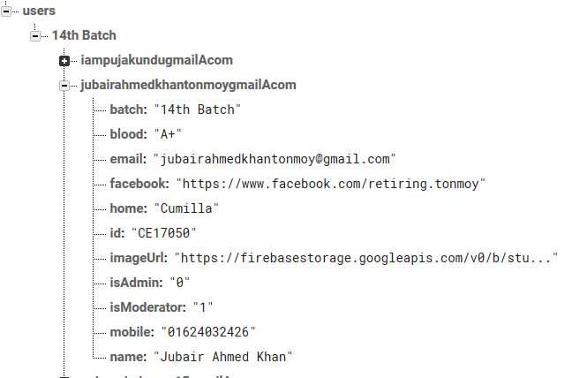
Moderator (onAccept method)
On accepting request.
Data in the “/account_request/…” directory.
After accepting, Data in the “/users/…” directory.

Slide 13
Admin
Admin is the real controller of this application.
From the Home Activity, User will go to Admin Activity, if ‘is Admin’ is set to 1.
Admin has accessibility over ‘Account Request’, ‘Moderator Request’, ‘View Report’, ‘Delete Account’.
Account Request and Moderator Request is implemented using Request Adapter. (same as previous)
Admin can view Account Request by batch wise that means admin has accessibility over all the Batches.

Slide 14
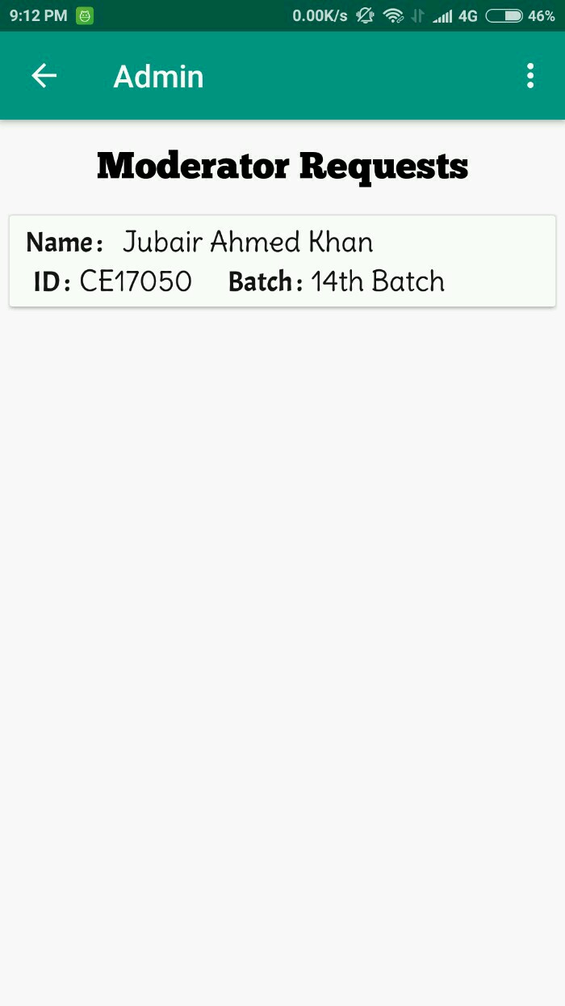
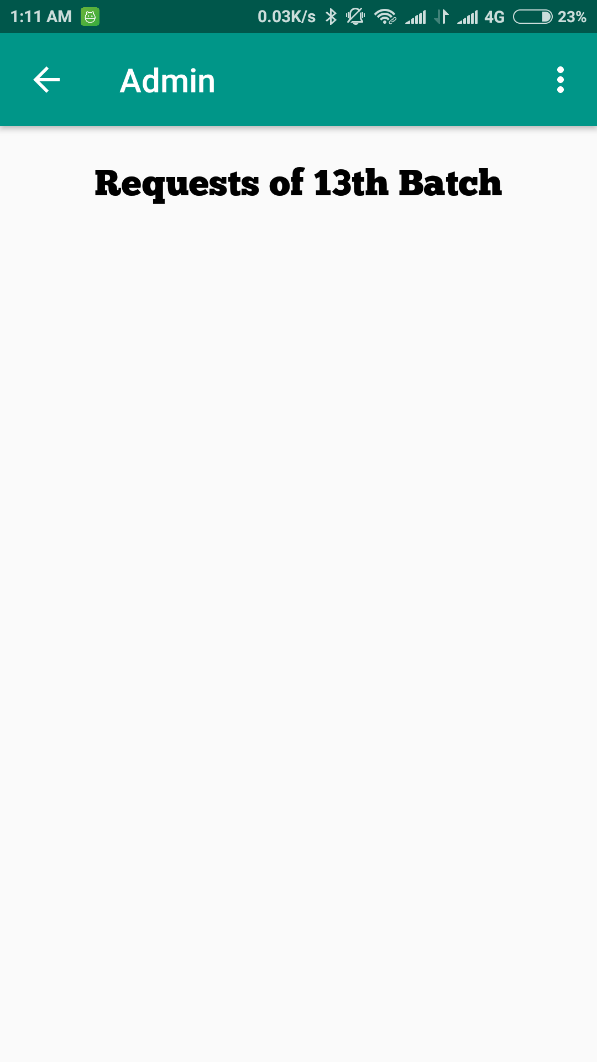
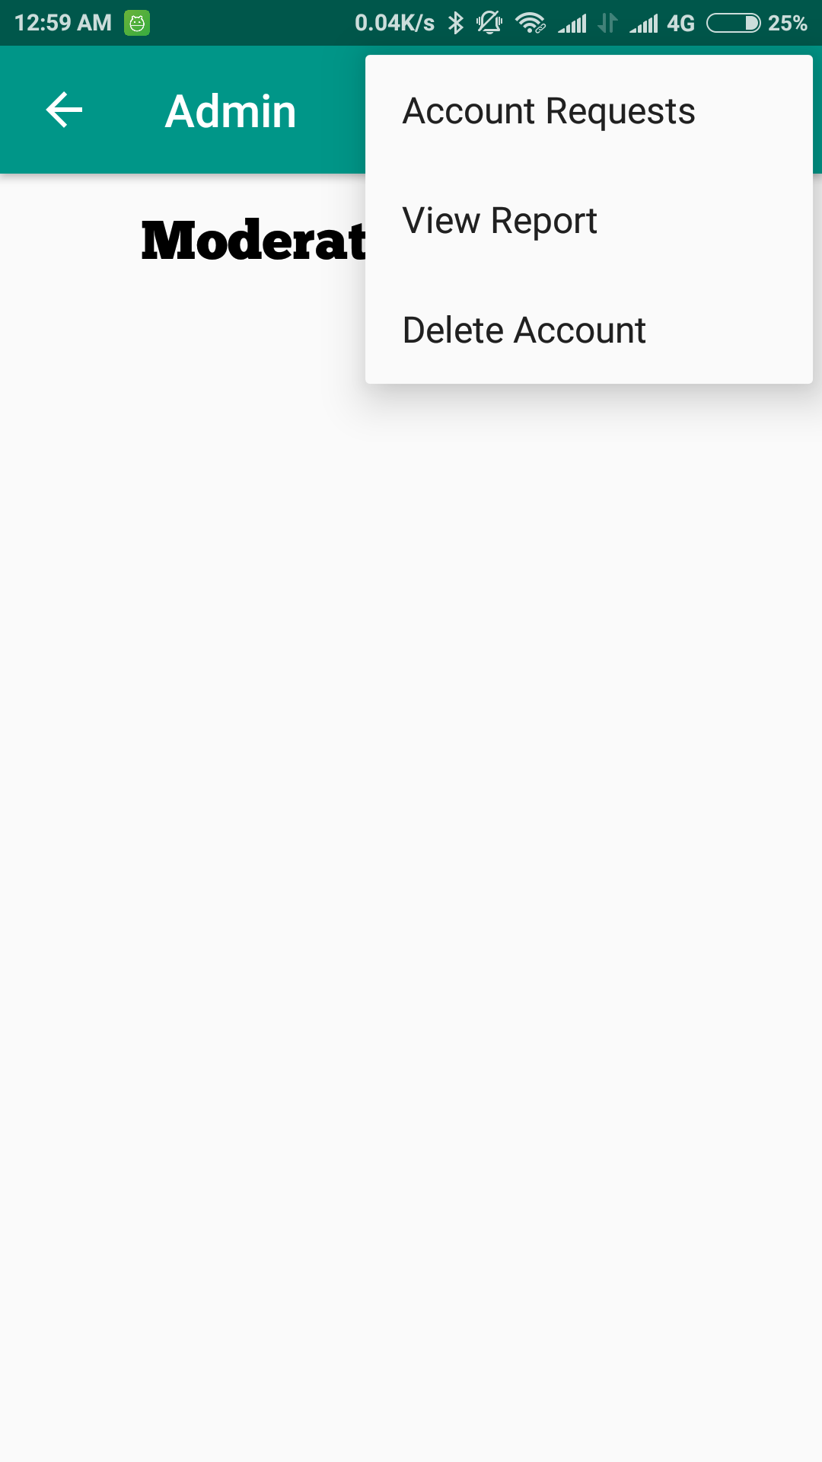
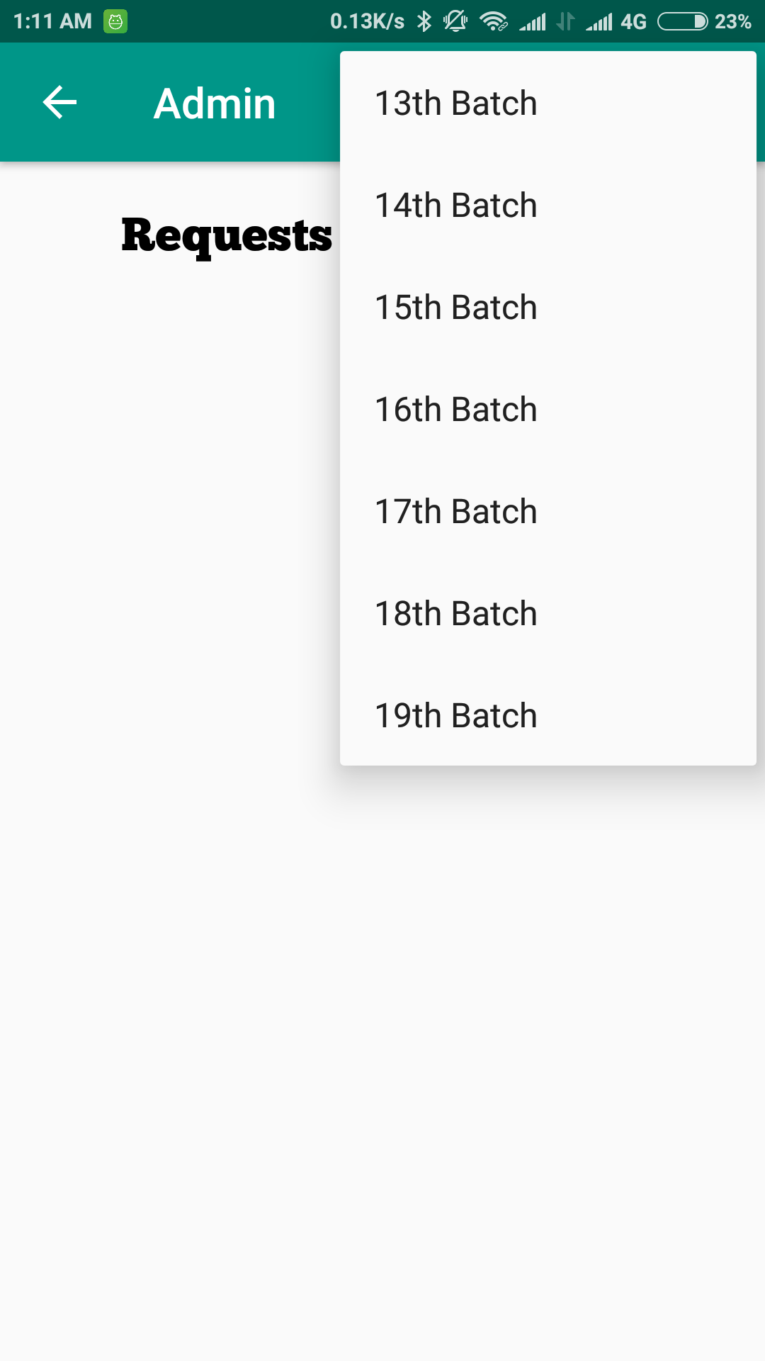
Admin (Moderator and Account Request)
First Activity for Admin
All the account request

Slide 15
Admin
Admin can view the Reports written by Users.
By seeing the reports, Admin can decide which features should be added or removed.
Another importance of viewing report is to delete account.
Admin may delete account if any account is reported to delete.

Slide 16
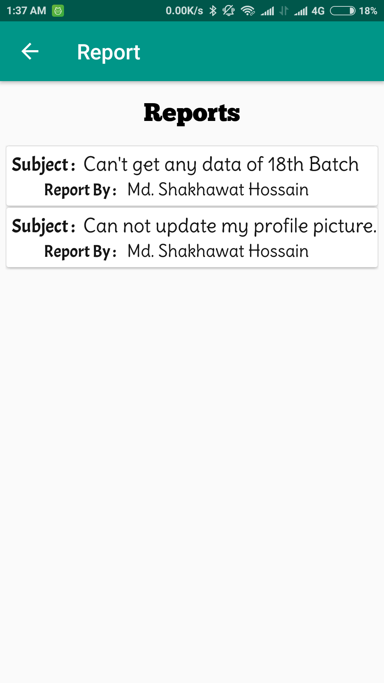
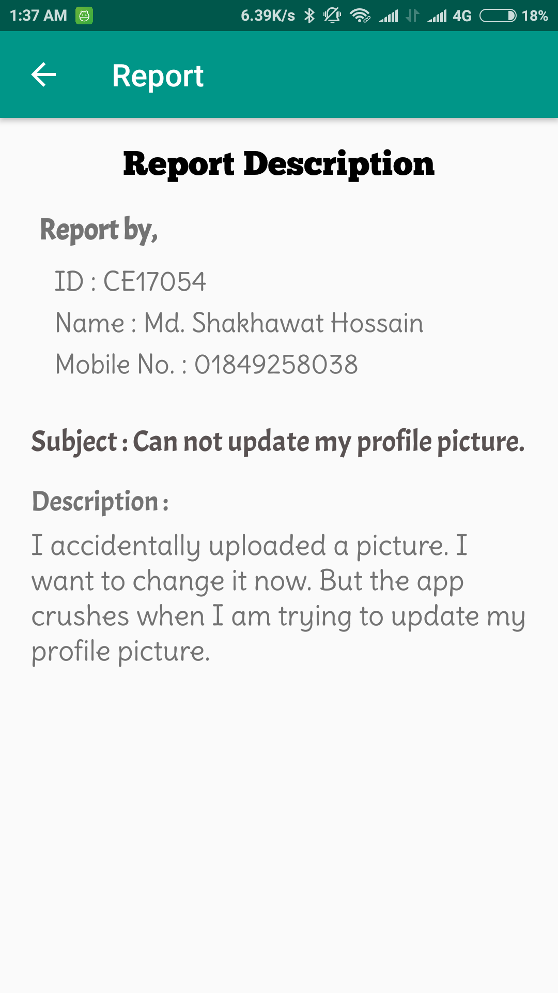
Admin (Viewing Reports)
Clicking over a report, opens it in a new activity.
Viewing Reports
Viewing a report widely

Slide 17
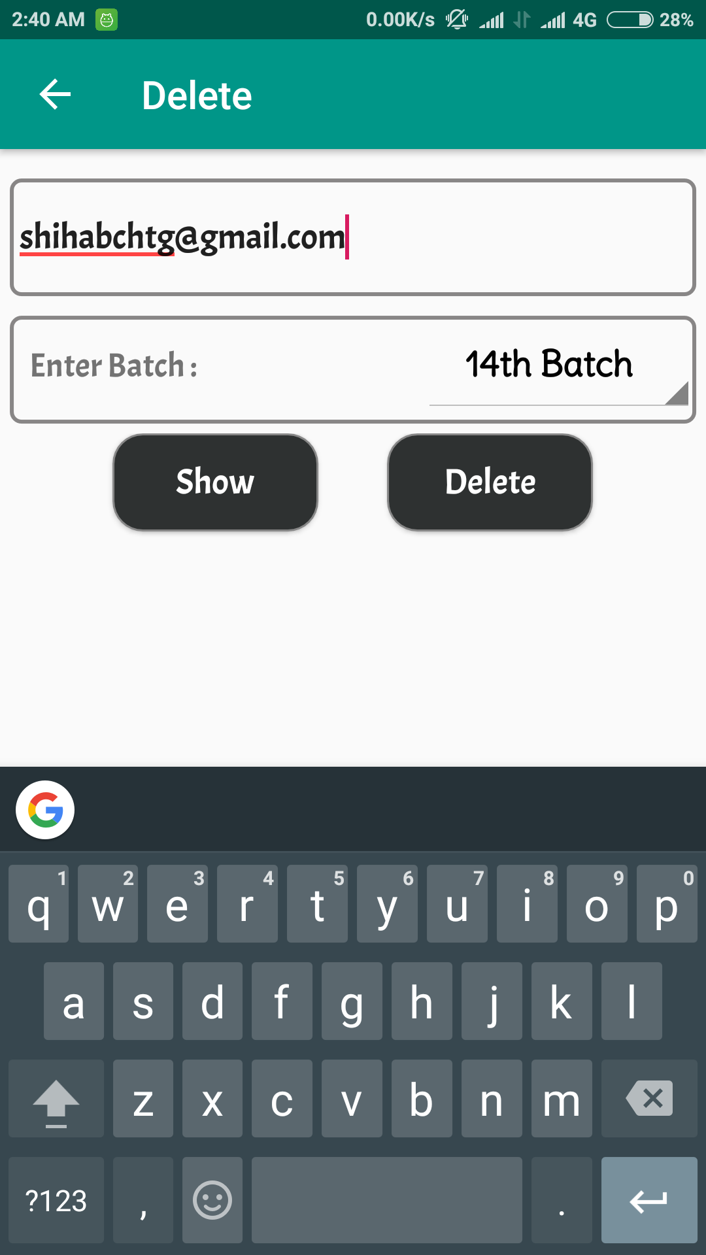
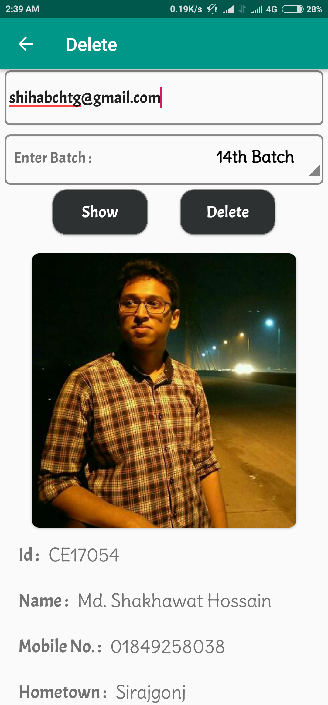
Admin (Deleting Data)
Show the user data before deleting it.
Inserting data to delete
Viewing before delete

Slide 18
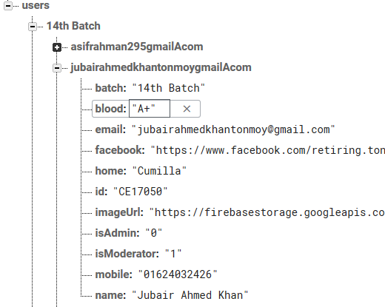
Moderator and Admin Identification
isAdmin = 0, means this user is not an Admin.
isModerator = 1, means this user is a Moderator.
User’s data in Firebase Database

Slide 19
User
The main target of this application is to show data to User optimally as well as decoratively.
User may edit his information and save it in database.
Whenever another user download data he will get the fresh data recently updated by User.
There are also features for writing reports, so that any bug or unusual outcomings can be listed.
Finally User can search information by Id, Name, Blood group, Mobile no. and Hometown.

Slide 20
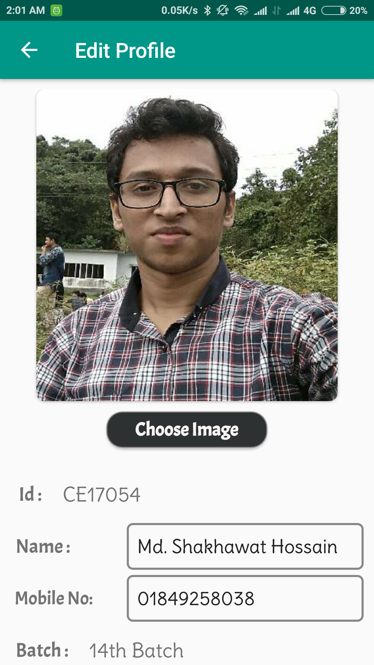
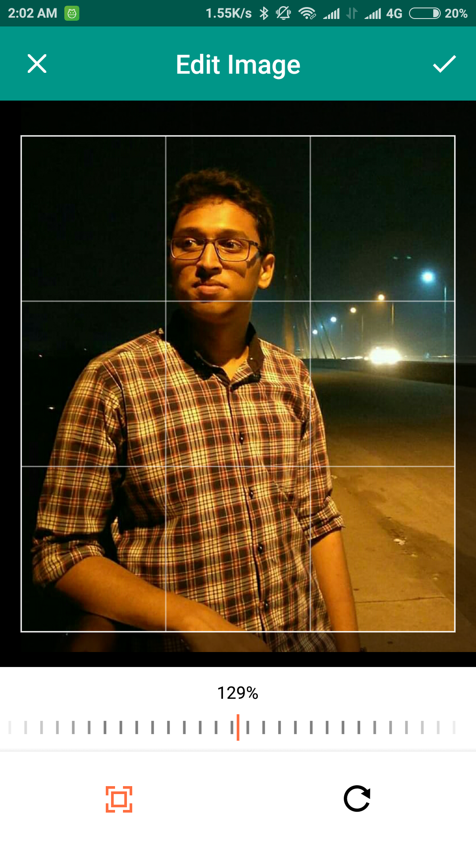
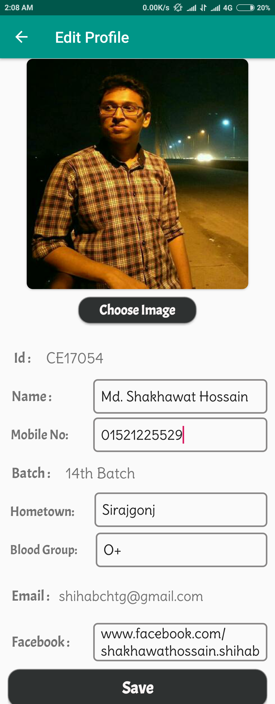
User (Editing Own Data)
Editing Profile
Set a new image
Save the changes

Slide 21
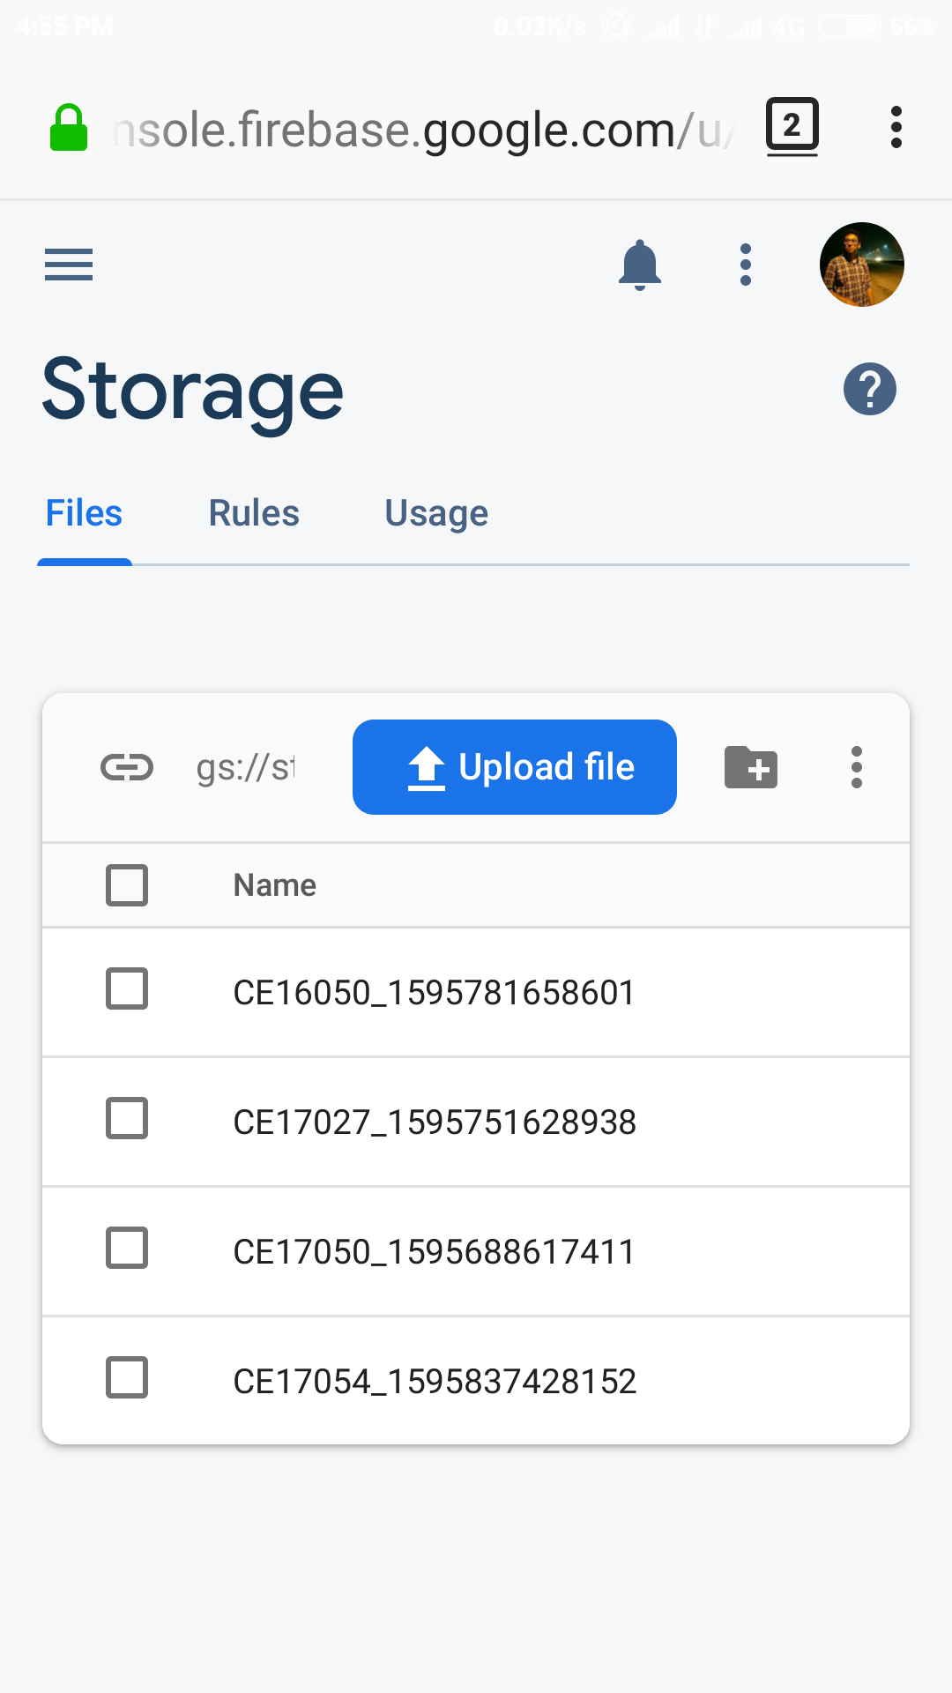
User (Image in Firebase)
The image selected by an user for his profile is uploaded.
In the users directory, inside the ‘imageUrl’ the link is saved.
By default, the value in ‘imageUrl’ is set as ‘x’.
where,
x= (lastDigitOfId) mod 4
By the value of x, default image is set.
Image Stored in Firebase Storage

Slide 22
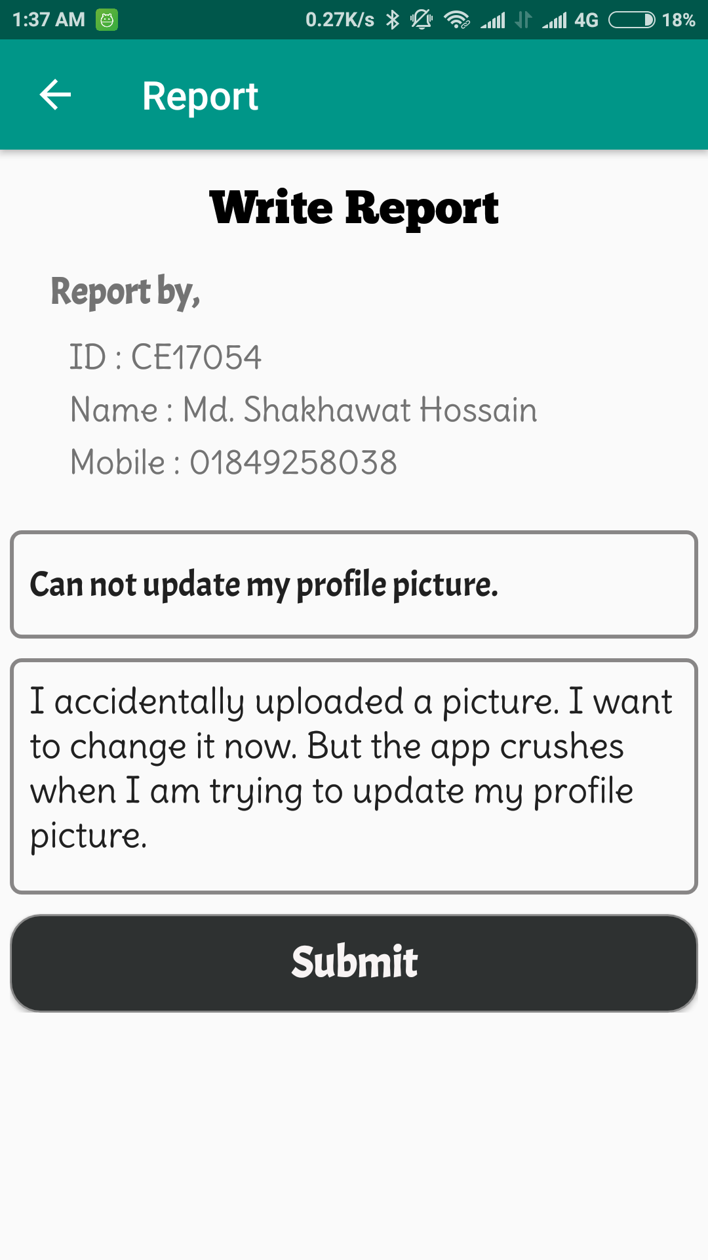
User (Writing Report)
Imported from Current User’s data
Writing Report

Slide 23
Download and Store Data
When User click Download icon, the download begins.
At first, the table for that Batch is truncated.
Then the new Data is inserted one by one.
After inserting data for a batch, the next batch follows the same process as previous.
So, When we click the card view of a Batch, data from that table is fetched and assigned to an array list to display.
This assigning follows some database query to show data by their roll & session. (as the order in the attendance sheet)

Slide 24
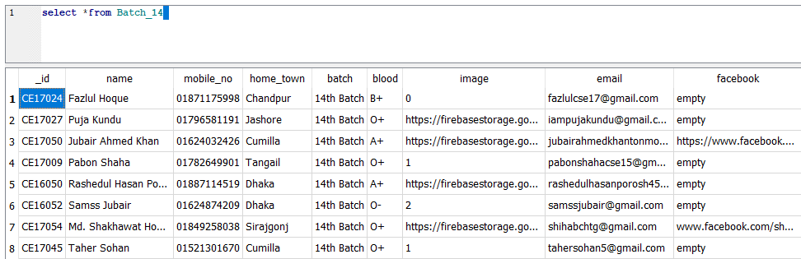
Data in Local Database

Slide 25
Viewing Data
On Clicking over a student’s picture, his details information is displayed in Show Info Activity.
In below there are three buttons.
The Green button directly makes voice call to that user.
The Blue button is linked with Facebook apps to show the Facebook Account of that student.
The Red button is to write email to the user, that will directly open Mail apps.
If the User has no Facebook application installed in his mobile then the Facebook link will open in browser.

Slide 26
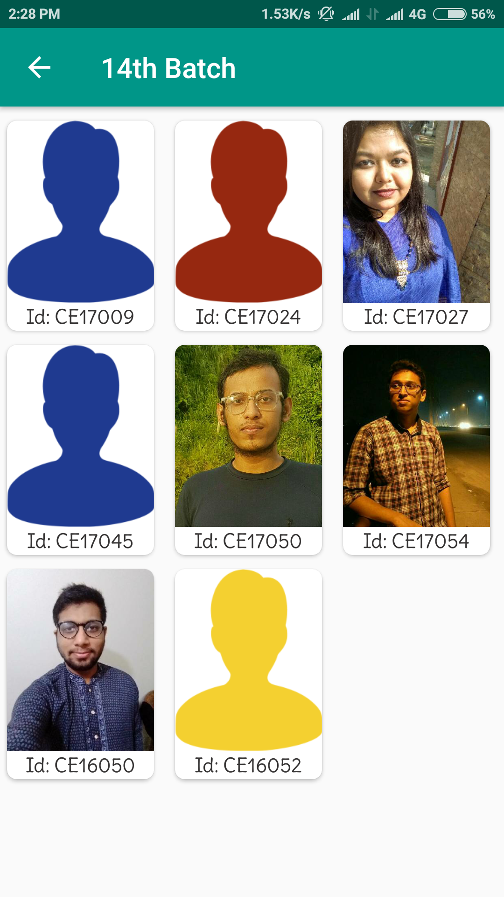
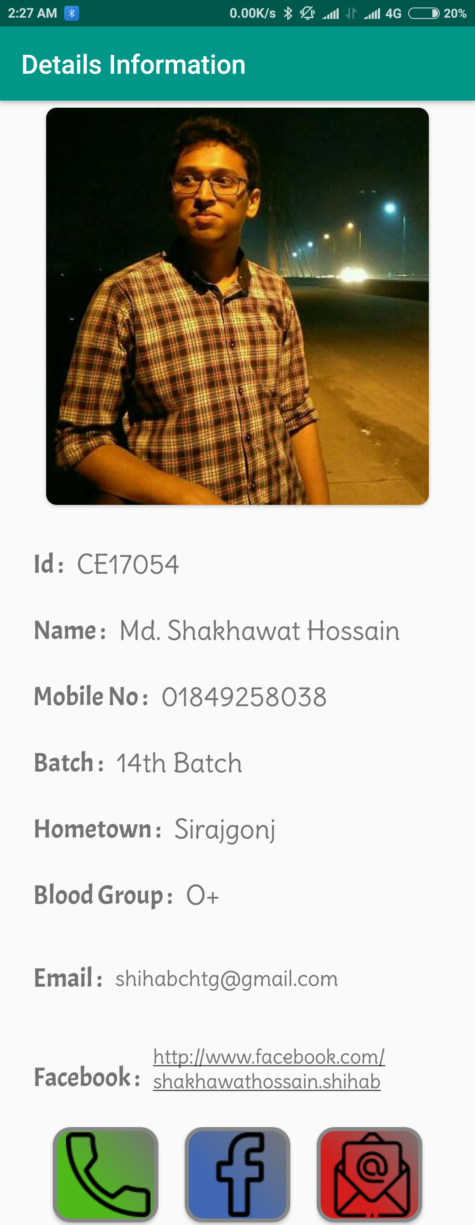
Viewing Data in Application
On Click over a user’s image

Slide 27
Searching
In my application the best part is searching.
There are searching keys like Id, Name, Blood Group, Mobile no. and Hometown.
At first, User have to select a searching key.
As I implemented search on data change, so all the data must be fetched and stored in an array list.
When we start inserting text in search box, the students related to that text is displayed.

Slide 28
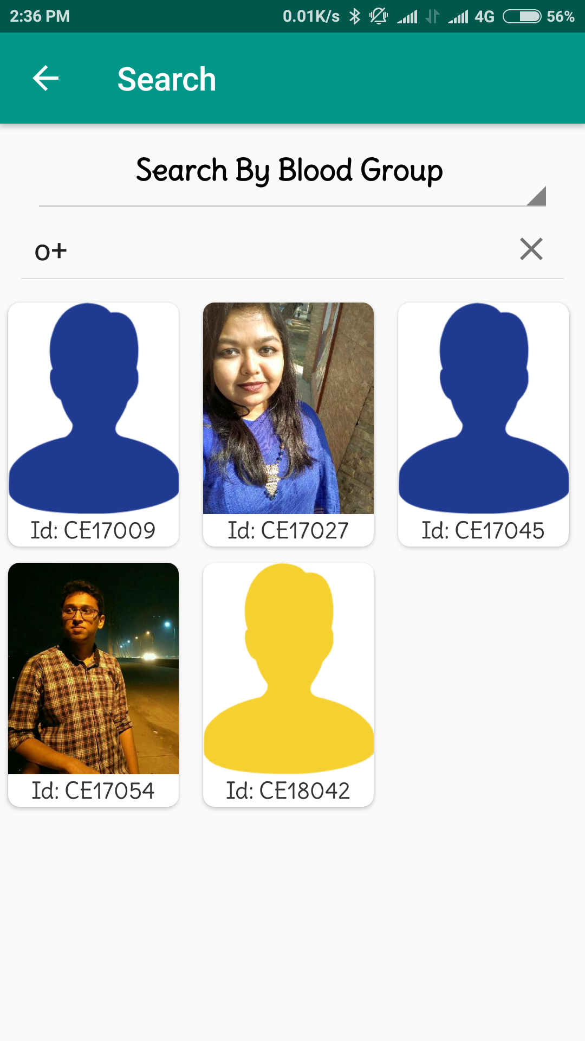
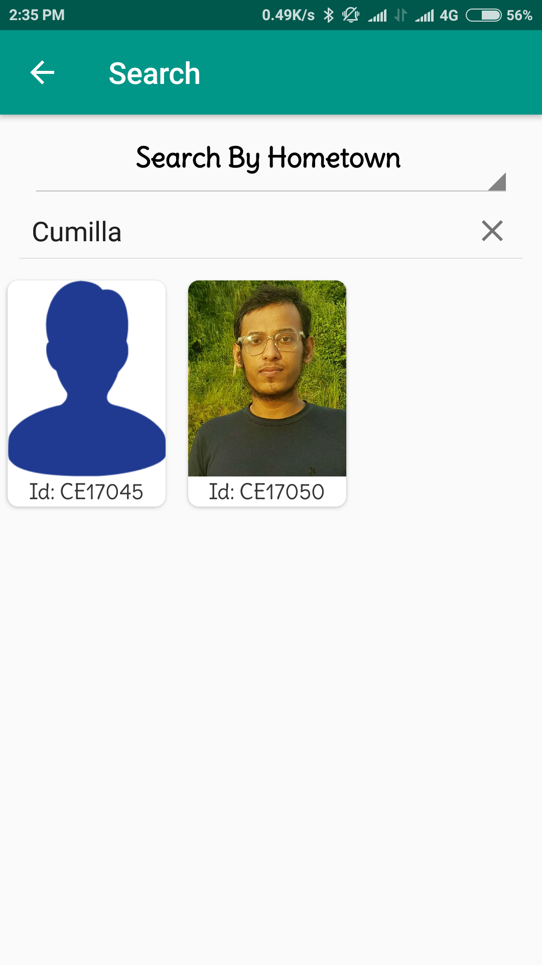
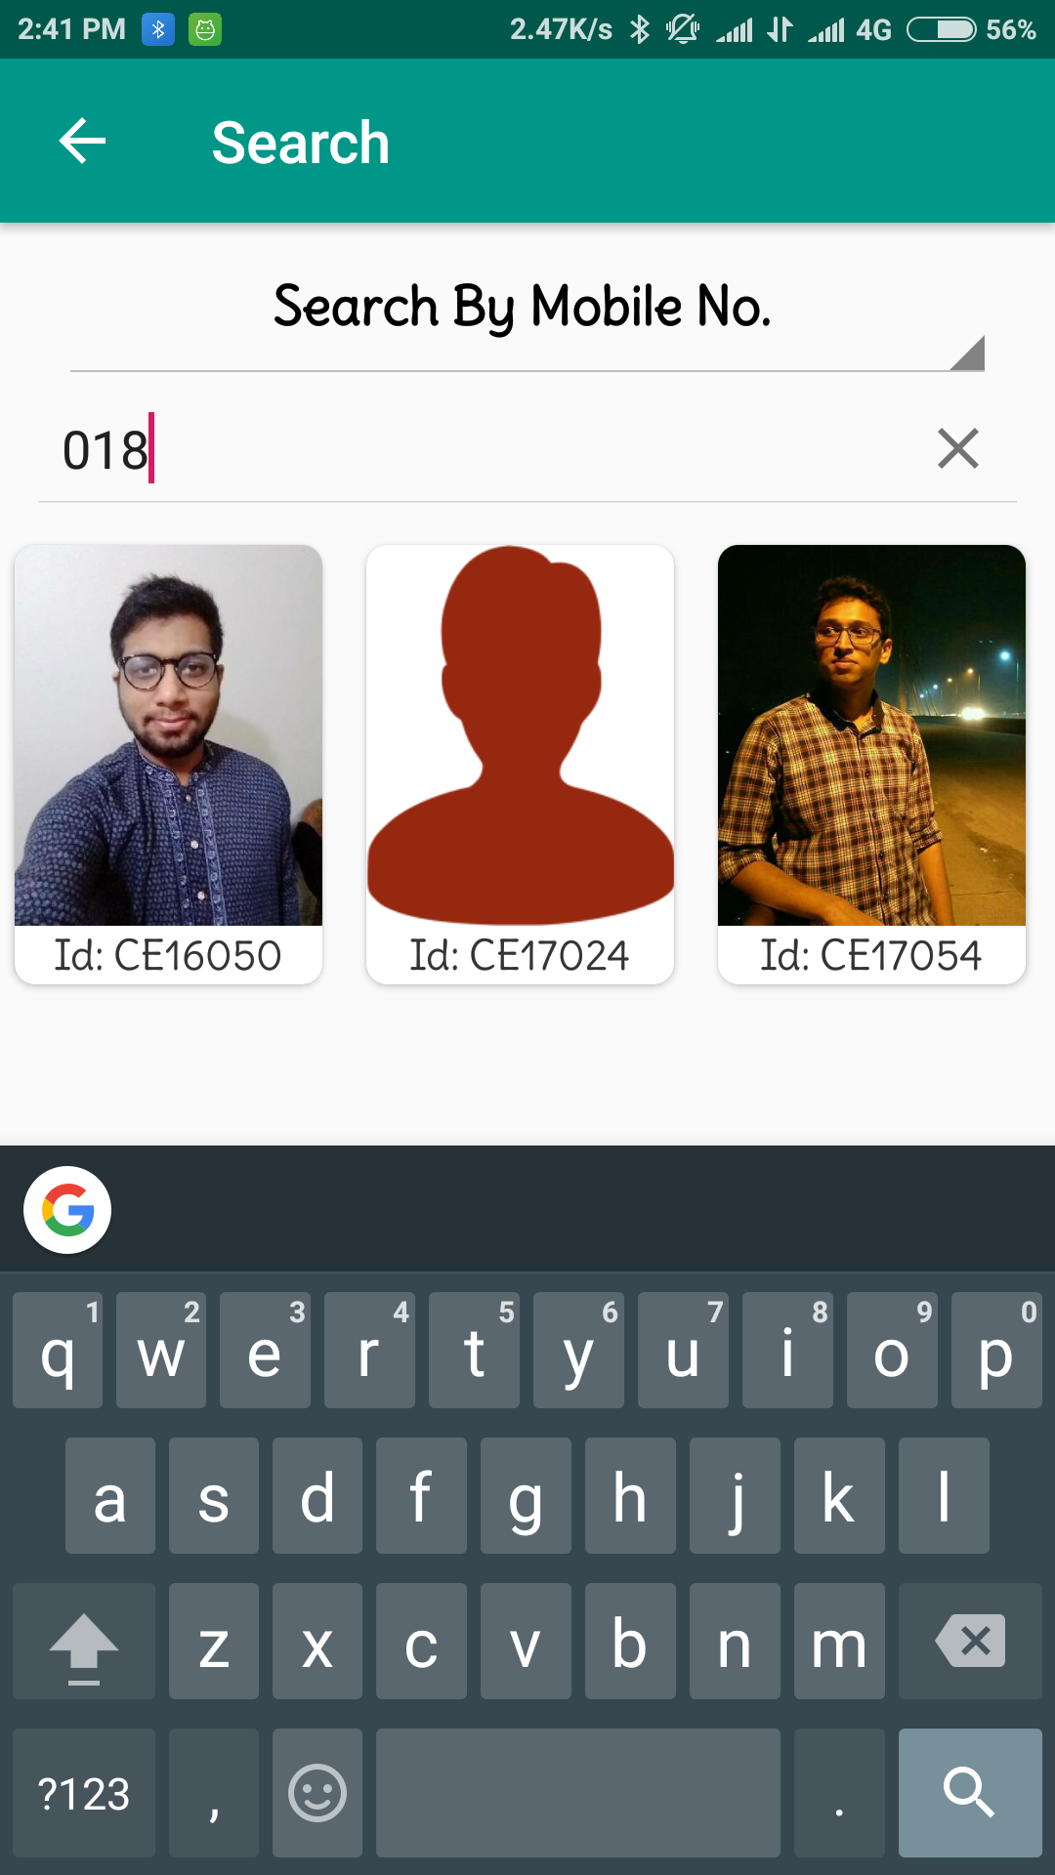
Some Examples of Searching

Slide 29
Limitations and Future Planning
As I am still learning, so the User Interface may not that much user friendly to users.
The Push Notification feature is not added. As a result, User can’t able to know when admin or moderator accept his request.
As I added system to create account for every user, so in future I can add google map in this application.
When it will be implemented user can see their current location as well as others location also.

Slide 30
Conclusion
To complete this project, I used my knowledge in Java and SQL, which was our academic courses in previous semesters.
So in other word, By doing this project I have implemented what I have learnt in previous semesters.
Finally, I would like to thank our respected teacher, Md. Mezbahul Islam for his excellent support and inspiration to complete this project.

Slide 31
Thank You

